Slide 1
POLICY AND TAX ADVISORY
Tax Exemptions for Persons Living with Disabilities
TAXATION OVERVIEW
PRESENTED BY:
J T KARIUKI

Slide 2
SCOPE OF PRESENTATION
Introduction
Income Tax Exemption Process
Checklist for Exemption
How the Exemption process is conducted.
Tax Incentives for Persons living with disability
How to calculate pay as you earn (PAYE) Self-Assessment Return
Tax Compliance Certificate

Slide 3
INTRODUCTION
Exemption from Income Tax for Persons Living with Disabilities was introduced by the Government through the enactment of The Persons Living with Disabilities ACT No. 14 of 2003.
The exemption from Income Tax (Sec 35 (1) and (2) of the Persons Living with Disabilities ACT) was operationalized through Legal Notice No 36 of 2010
The National Council for Persons Living with Disabilities (NCPWD) has the statutory mandate for the implementation of the ACT
A person with disability shall not be eligible to apply for tax exemption unless he or she is registered with the Council.
KRA is responsible for issuance of Certificate of Exemption from Income Tax only after the application has been processed by the NCPWD

Slide 4
Tax Exemption Process
A person living with disabilities may apply for exemption through the Council
The Council shall after vetting an application for tax exemption, give a recommendation in Form 2 set out in the Schedule to the Commissioner and process the application in the KRA System (iTax).
The Commissioner shall review the application and process the Certificate of Exemption which is issued to the Taxpayer electronically through their registered email.

Slide 5
Checklist for Income Tax Exemption
Registration with the National Council of persons with disabilities
Download and fill duplicate application form (1) from the national council of persons with disability website.
A copy of pin certificate
Proof of Income (business license, finance statements, rent schedule, etc)
A certified copy of current pay slip where applicable
A copy of the National Identification card
A copy of a doctors medical report from the government gazetted hospitals
A letter from the employer where applicable stating the nature of disability and how it affects performance
Tax Compliance certificate

Slide 6
How the Exemption process is conducted
Council shall establish a committee, whose members shall include a medical doctor, for the purposes of vetting applications for tax exemption.
The Council shall after vetting an application for tax exemption, make a recommendation in Form 2 set out in the Schedule to the Commissioner.
Where the recommendation is to grant the exemption, the Council shall, on behalf of the taxpayer, submit the online application in iTax and upload all the required documents as per the checklist shared.
In order to avoid instances of rejection, applications not fulfilling ALL the document requirements should not be made in the KRA System until such is provided.
The Income Tax Exemptions unit at Head Office shall process the applications in the KRA System (iTAX) upon which an electronically generated Certificate of Exemption is sent to the Taxpayer’s email registered with KRA.
Where the process is a rejection, a notice of rejection giving reasons thereof is sent to the Taxpayer through the registered email
Tax Exemption Certificate valid for five (5) years.

Slide 7
TYPES OF INCOME CHARGEABLE TO TAX
Section 3 of the Income Tax act outlines the following sources of income as taxable
Business Income from any trade or profession
Income from employment or from services rendered
Rent Income
Pensions Income
Investment Income - dividends and interest among others

Slide 8
TAX RELIEF
Sec 29 of the Income Tax ACT, CAP 470 provides that a resident individual who for a year of income is in receipt of taxable income and has furnished a return of income in respect of that year of income, shall, in respect of that year of income, be entitled to a personal relief which shall be set off against tax payable by him for that year of income at the rate and subject to the limitation specified.

Slide 9
Types of Reliefs and Applicable Rates
Personal relief for Resident Individuals :– Sh. 28,800 per annum.
Relief on premiums paid for Life, Education policy for Resident Individuals:- 15% of premiums paid subject to a maximum of Shs. 60,000/= per annum .
Relief/deduction of interest paid on Mortgage for owner-occupied properties, subject to a maximum of Kshs. 150,000/- per year.
Contribution to registered defined benefit fund or defined contribution fund is tax-deductible – maximum Kshs. 20,000/= per month
Life or education policies – whose term commences on or after 1st January, 2003.
Health Insurance policy whose term commences on or after 1st January, 2007.
For persons living with disability who have been registered with NCPWD and have been granted Certificate of Exemption by KRA, the first Ksh 150,000 per month or Ksh 1,800,000 per annum is tax exempt

Slide 10
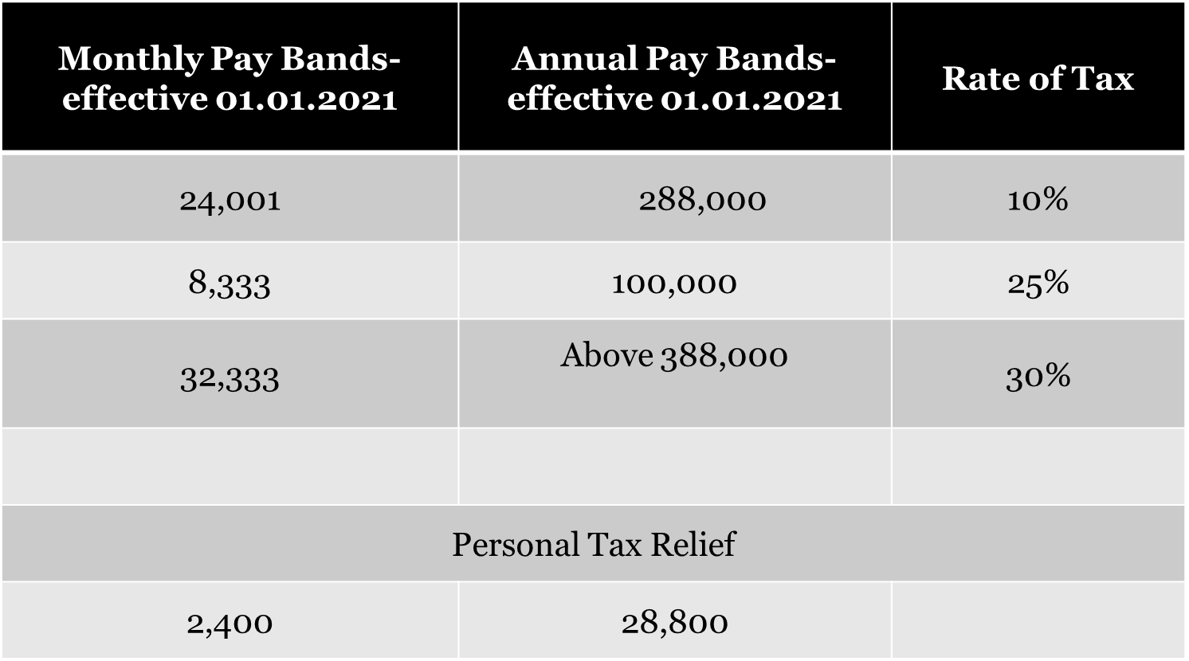
COMPUTATION OF INCOME TAX

Slide 11
SELF – ASSESSMENT RETURN
This is a form in which a taxpayer is required to declare his income and compute taxes payable at the end of each calendar year.
The Self Assessment Return should be completed and submitted to the Domestic Taxes Department through the online platform i Tax on or before 30th June of the subsequent year to the Year o Income being declared.

Slide 12
INDIVIDUAL (EMPLOYEES AND SOLE PROPRIETORSHIPS)
The return of income and accounts for any year of income should be submitted between 1st January and 30th June of the following year.
For example, the return of Income and Accounts for 2019 was due on or before 30th June 2020, and the current return for 2020 on or before 30th June 2021.
Note:
A valid certificate of exemption is mandatory while
filing the annual return to enable the system to
calculate the tax exempt amount

Slide 13
Requirements for Tax Compliance Certificate
All persons living with disability will be required to have a tax compliance certificate before they are issued with the exemption certificates. They must be compliant in:
Filing of tax returns on or before due date for all applicable tax obligations.
Payment of tax on or before the due date.
Clearance of all outstanding tax debt.

Slide 14
REQUIREMENTS FOR TAX COMPLIANCE CERTIFICATE CONT’D………
Application for TCC is done through i Tax platform.
Visit our website on www.itax.go.ke
Log in with your profile and click on apply for tax compliance certificate on the extreme top right corner of your profile
File the online application form and click submit
TCC will be sent to taxpayer’s email address.

Slide 15
THE END
THANK YOU

